Slide 1

Geospatial Analysis using Google Earth Engine

Slide 2
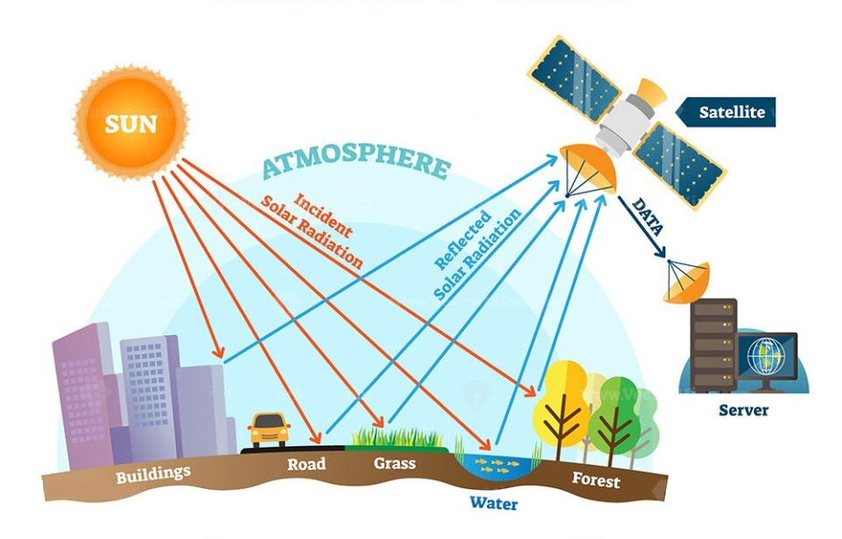
What is Remote Sensing ?

Slide 3
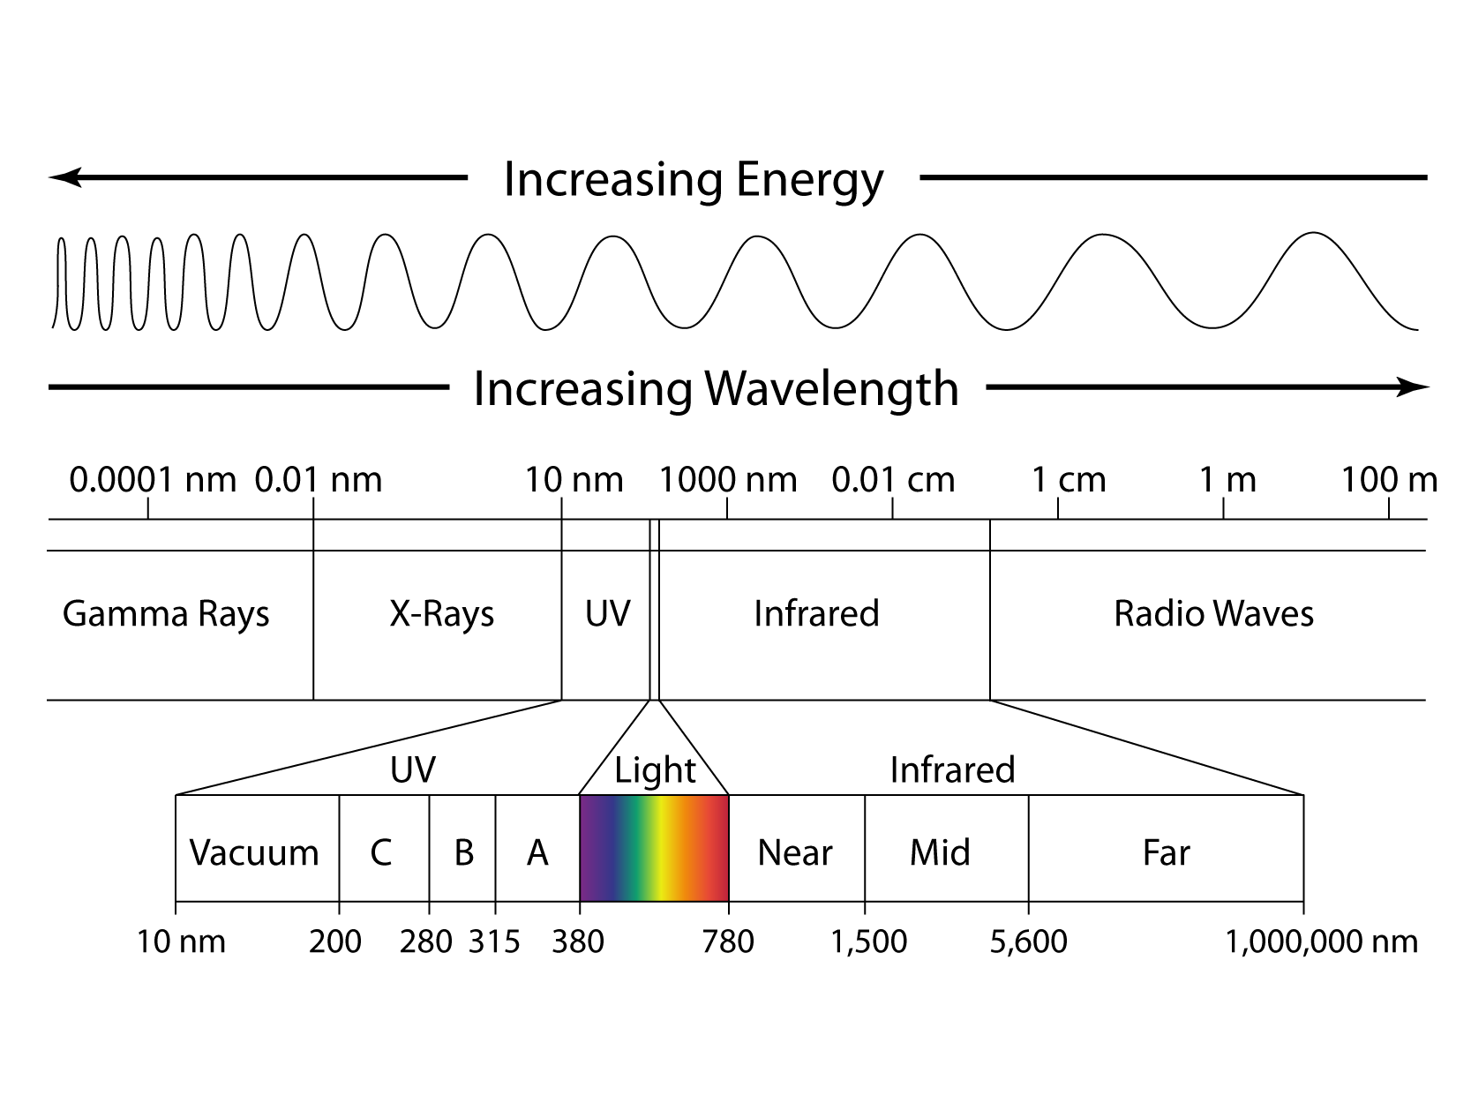

Slide 4
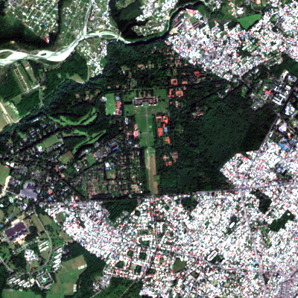
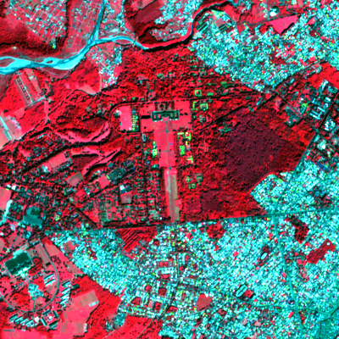
NCC v/s FCC

Slide 5

What is Geospatial Technology ?

Slide 6
Geo - Relating to the earth.
Spatial - Relationships between objects or phenomena in space.
Geospatial - Analysis and visualization of data that is related to locations on the earth's surface.
Geospatial Technology - Set of tools and techniques used to gather, process, analyze, and visualize spatial data.

Slide 7



Types of Platforms
UAV
Aerial
Satellite

Slide 8






Geospatial Software's

Slide 9
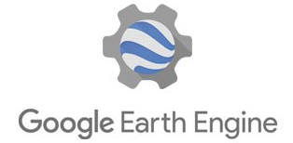





Open-Source Alternatives

Slide 10
Why Google Earth Engine?
Cloud based Platform
Data Access
Machine Learning Integration
Collaboration and Sharing

Slide 11
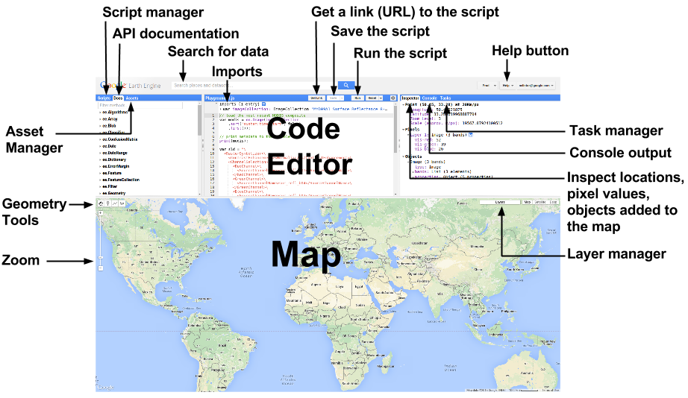

Slide 12



Accessibility
JavaScript
Python
API

Slide 13

References

Slide 14
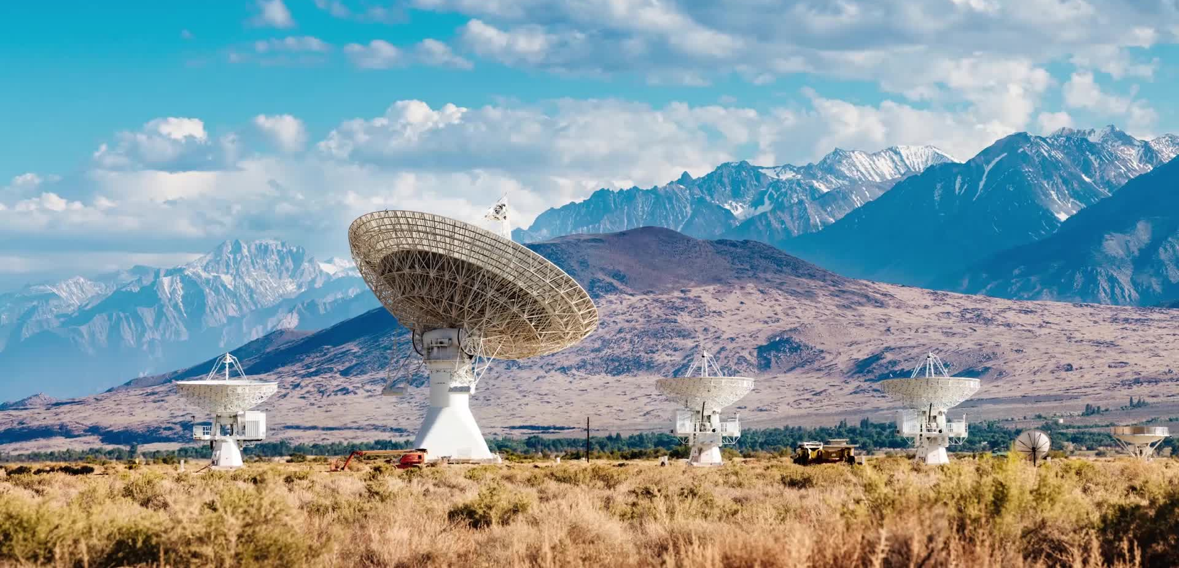



Thank You..!!
@HarshAditya Gaur
gaurharsh24@gmail.com
@harshadityagaur

